Slide 1
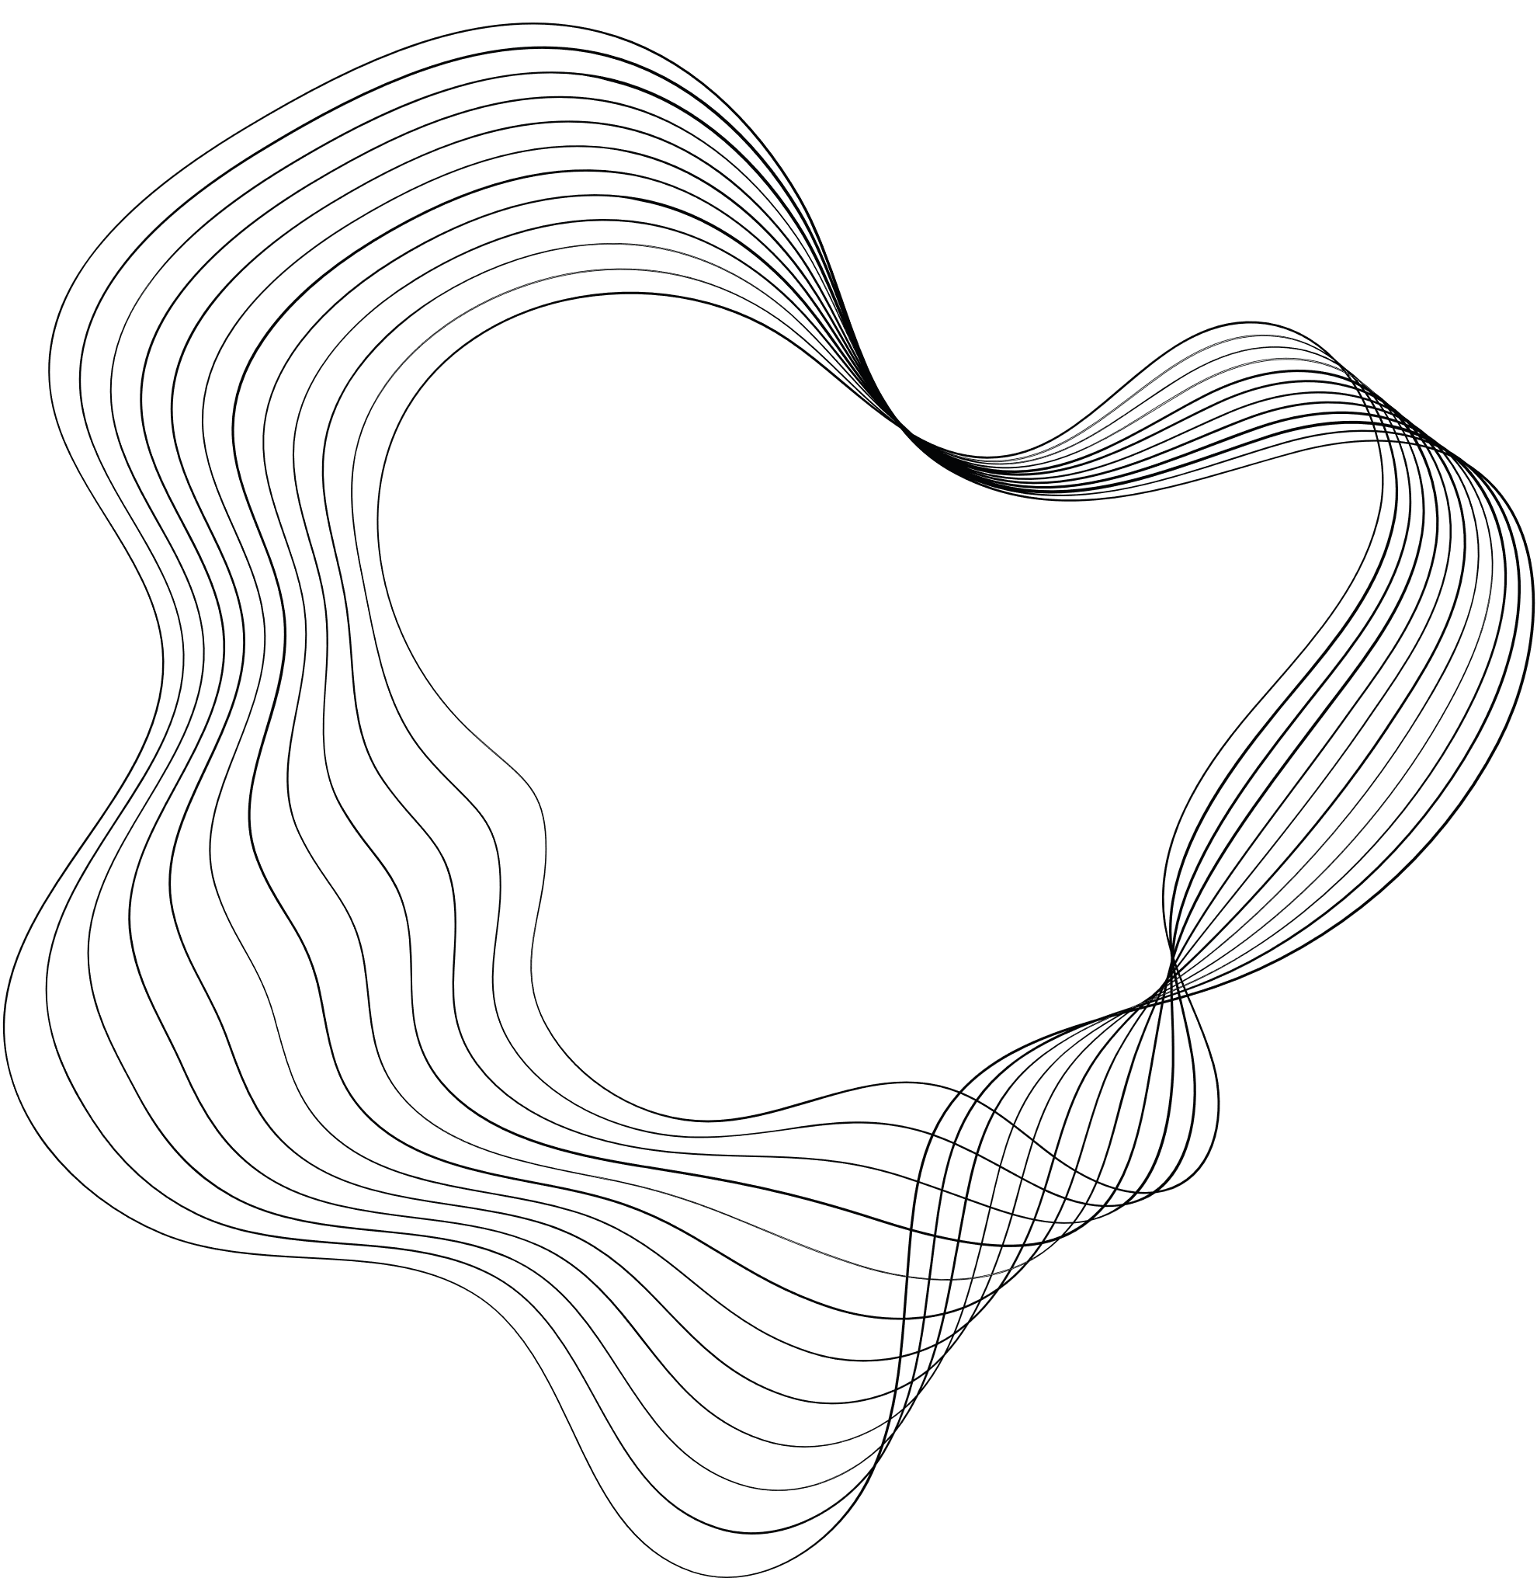



Topic 5
Process Modeling -
Data Flow Diagram (DFD)
SYSTEMS ANALYSIS AND DESIGN

Slide 2


LEARNING OBJECTIVES
SEGI UNIVERSITY
01
Process Modeling
02
Data Flow Diagram (DFD)
03
DFD Leveling
04
DFD Balancing

Slide 3
.
ANALYSIS PHASE
SEGI UNIVERSITY
Analysis refers to breaking a whole into its parts with the determined of understanding the parts’ nature, functions, and interrelationships.
The planning phase deliverables are the key inputs into the analysis phase.
The basic process of analysis involves three steps:
Understand the existing situation (the as-is system)
Identify improvements
Define the requirement for the new system (the to-be system).

Slide 4
Process Modelling
Technique for organising and documenting the structure and flow of data through a system’s processes
A process model is a graphical way of representing how a business system should operate. It illustrates the processes or activities that are performed and how data move among them.
Utilise information gathered during requirements determination
A process model can be used to document the current system (i.e., as-is system) or the new system being developed (i.e., to-be system)

Slide 5
Data Flow Diagram (DFD)
A data flow diagram (DFD) is a technique that graphically depicts the flow of data through a system and the processing performed by that system
Pictorially shows system components, interrelationships, boundaries, inputs and outputs at various levels of abstraction
DFD is a technique that support systems thinking

Slide 6
Four Types of DFD
Current Physical DFD
Usually obtained from original project for current system – helps us to understand current working
Current Logical DFD
Simplify physical DFD and reduce down to what it is actually doing rather than how and grouping processes that do similar things
New Logical DFD
Depending on Analysis technique then suggest and draw improvements
New Physical DFD
Map to technology during Design

Slide 7
DFD Symbols (Gane & Sarson)
Four components:
Process
Data Flow
Data Store
Source/Sink (External Entity)

Slide 8
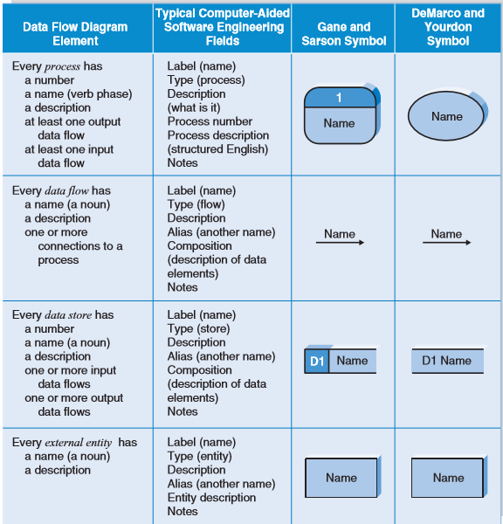

Slide 9
DFD Components: Processes
Id number
An activity or function that is performed for some specific business reason
Can be manual or computerised
Naming convention: verb + noun i.e. start with a verb and end with a noun!
Rules
Processes cannot just have outputs else it’s a miracle process!
Processes cannot just hace inputs else it’s a black hole!
Input must be sufficient to produce the output else it’s a grey hole!
Process
Description
input
1
output
input
Manage Payroll
output
input
output
Synonym: transform

Slide 10
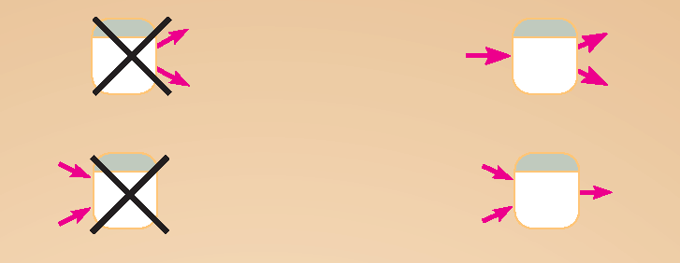
DFD Diagramming Rules Process
Miracle Process
No process can have only outputs or only inputs…processes must have both outputs and inputs.
Black Hole
Process labels should be verb phrases.

Slide 11
Logical and Physical Processes
Logical
Physical
1
1
Manage Student Marks
School of Science & Tech
Manage Student Marks
1.2
1.2
Mark Assessments
Mark Assessments
Module Leader
1.2.1
1.2.1
Calculate Aggregate Marks
appCalcAggMark.xls
Calculate Aggregate Marks

Slide 12
DFD Components: Data Flows
name
Depicts data that are in motion and moving as a unit from one place to another in the system
Represents input to a process and output from a process
Single data flows consist of a single meaningful data attribute
Composite data flow is one that contains other data flows and are used in higher level DFDs for clarity

Slide 13

DFD Diagramming Rules Data Flow
Data flow from a process to a data store means update (insert, delete or change).
Data flow from a data store to a process means retrieve or use.

Slide 14
Logical and Physical Data Flows
Logical
Physical
1
HTML:
Order Form
1
Order
Process Order
Java OPS
Process Order
1
1
PRINTOUT:
Account Summary
Account Summary
Generate Account Summary
Sage Accounts
Generate Account Summary
Student
Details
SQL Insert:
New Student
D2
Students
D2
Oracle: Students
1
2
1
Signed S1 Form:
Valid Student
2
Valid Student
Validate Student Application
Admin Office
Register Student
Registrar
Validate Student Application
Register Student

Slide 15

DFD Components: Data Stores
Depicts data at rest
May represent data in
File folder
Card index
Computer-based file
Notebook
Only system processes can read/write to data stores
Data stores depicted on a DFD store all instances of data entities depicted on an ERD
M = manual store
D = computer store

Slide 16
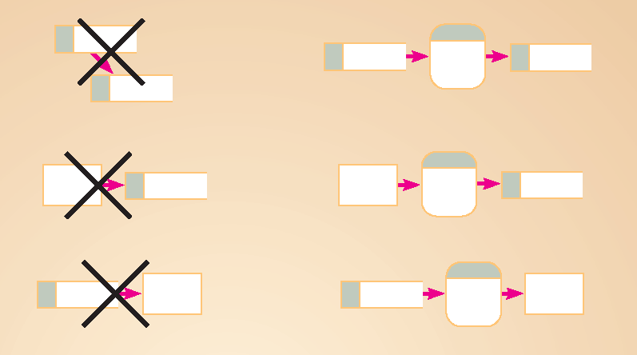
DFD Diagramming Rules Data Store
All flows to or from a data store must move through a process.

Slide 17
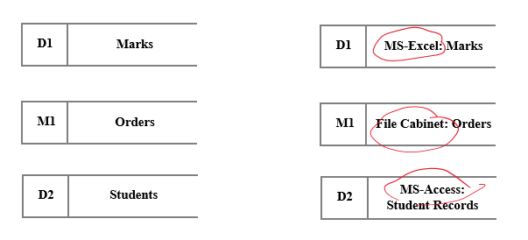
Logical and Physical Data Stores
Logical
Physical
M = manual store
D = computer store

Slide 18
DFD Components: External Entities
Defines a person, department, other system or other organisation that lies outside the scope of the project but that interacts with the system
customers, suppliers, contractors, government agencies, banks
Provides inputs to the system and receives outputs from the system
External Entities
Synonym: Source/Sink

Slide 19

DFD Diagramming Rules External Entities
No data moves directly between external entities without going through a process.
Interactions between external entities without intervening processes are outside the system and therefore not represented in the DFD.
Source and sink labels should be noun phrases.

Slide 20
How to draw DFD?
https://www.youtube.com/watch?v=ztZsEI6C-mI

Slide 21
DFD LevelLIng & Balancing
Decompose DFDs into lower-level diagrams (DFD levelling)
Understand DFD balancing

Slide 22
DFD Levels of Abstraction
Context Diagram
Level 0
Level 1
Level 2
Level-3
External Entity
2
2.2
2.2.2
1
Process
2.1
2.2.1
Elementary Process Description
(Logic Modelling)
Decision tables
Decision trees
Structured
English
Sub-Process
Sub-Sub-Process
0
2
2.2
2.2.2
System
Process
Sub-Process
Sub-Sub-Process
3
2.3
2.2.3
Process
Sub-Process
Sub-Sub-Process
External Entity
A rule of thumb : Max of 7 levels with a max of 9 processes per level

Slide 23
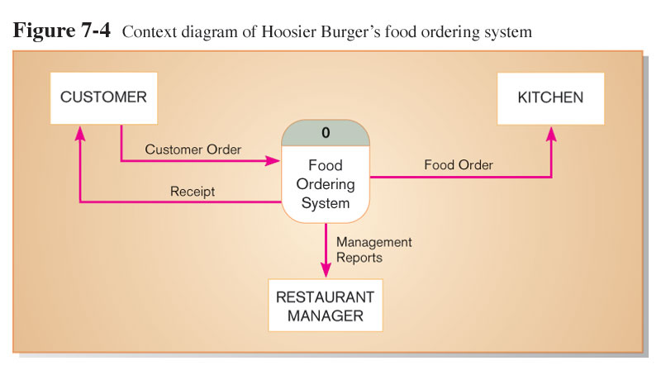
Context Diagram
Context diagram shows the system boundaries, external entities that interact with the system, and major information flows between entities and the system.
NOTE: only one process symbol, and no data stores shown.

Slide 24
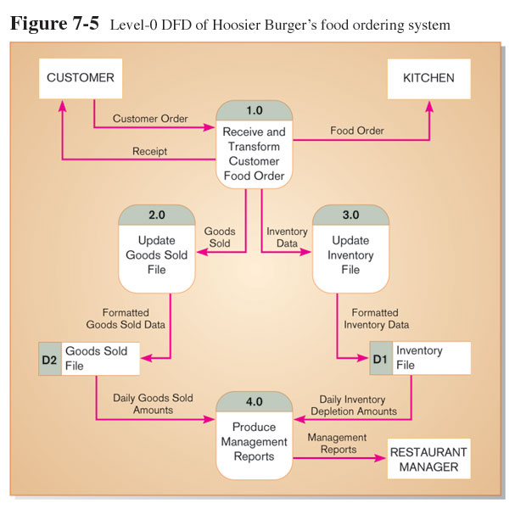
Level-0 DFD
Level-0 DFD shows the system’s major processes, data flows, and data stores at a high level of abstraction.
Processes are labeled 1.0, 2.0, etc. These will be decomposed into more primitive (lower-level) DFDs.

Slide 25
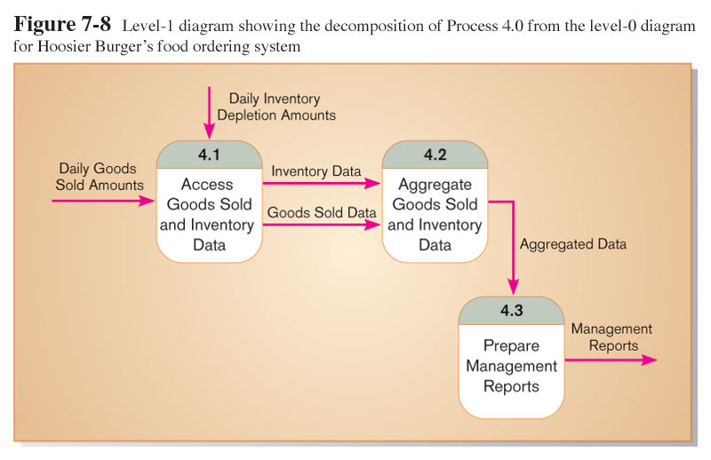
Level-1 DFD
Processes are labeled 4.1, 4.2, etc. These can be further decomposed in more primitive (lower-level) DFDs if necessary.

Slide 26
When do we stop levelling?
Hoffer et al. (2001) recommend we stop when:
each process is a single decision, calculation or database operation;
each data store represents data about a single entity e.g. employee, customer, product etc;
system user does not want further detail;
every data flow does not need to be further divided to show how different types of that flow are processed;
Notes:
Have fewer rules than DFDs – users don’t want to learn the DFD language so something easier is welcome
Very close to how users’ think
Helps analyst to understand what questions to ask about processes and how to move from big picture to lower levels of details
So, during Analysis we:
-apply requirements analysis technique
-design and implement appropriate requirements gathering techniques
-create use cases for complex functional requirements
-create process (DFD) model
-create data (ERD) model

Slide 27
DFD Balancing
When decomposing a DFD, you must conserve inputs to and outputs from a process at the next level of decomposition
This is called DFD Balancing
The number of net inputs and outputs from/to the environment shown on the Context diagram must not change in lower level DFDs

Slide 28
DFD Balancing
The conservation of inputs and outputs to a data flow process when that process is decomposed to a lower level
Balanced means:
Number of inputs to lower level DFD equals number of inputs to associated process of higher-level DFD
Number of outputs to lower level DFD equals number of outputs to associated process of higher-level DFD

Slide 29
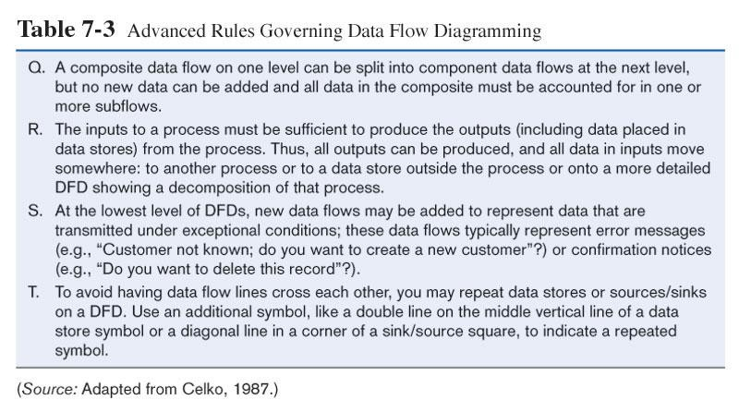
DFD Balancing Rules

Slide 30
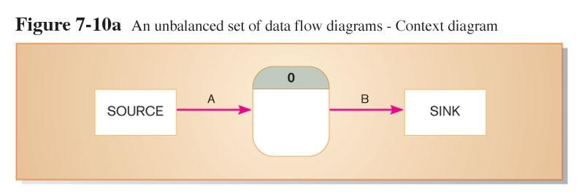
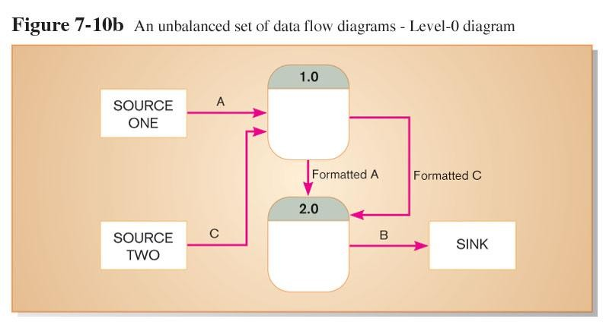
Unbalanced DFD
1 input
1 output
This is unbalanced because the process of the context diagram has only one input but the Level-0 diagram has two inputs.
2 inputs
1 output

Slide 31


Balanced DFD
Input
3 outputs
These are balanced because the numbers of inputs and outputs of context diagram process equal the number of inputs and outputs of Level-0 diagram.

Slide 32
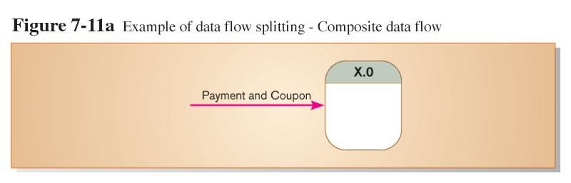
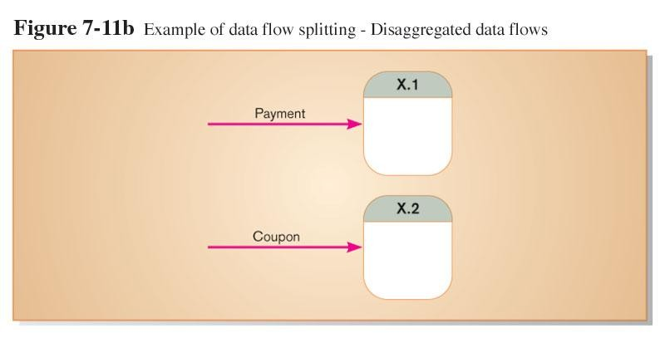
Data Flow Splitting
A composite data flow at a higher level may be split if different parts go to different processes in the lower level DFD.
This remains balanced because the same data is involved, but
split into two parts.

Slide 33
Context Diagram
Maintain Stock System
Production Planning
Supplier
Delivery Note
Production Plan
Supplier Details
Update Form
0
Maintain Stock System
Delivery Note
Purchasing
Material Requirements List
Stock Withdrawal
Note
4 INPUTS
Factory
3 OUTPUTS

Slide 34
Level 0 DFD – Current Logical
Maintain Stock System
0
Production Planning
Production
Plan
1
BOM Details
Maintain planned call-off
M1
Bill of Materials
Supplier
Delivery
Note
2
Planned Call-off Details
Stock Withdrawal
Note
Maintain
stock cards
Stock Details
Factory
Supplier Details
Update Form
M2
Stock Cards
Delivery Note
3
Prepare materials req. list
Stock Details
Purchasing
Materials Requirements List
4 INPUTS
Balanced?
YES
3 OUTPUTS

Slide 35
Guidelines for Drawing DFDs
Completeness
DFD must include all components necessary for system.
Each component must be fully described in
the project dictionary or CASE repository.
Consistency
The extent to which information contained on one level of a set of nested DFDs is also included on other levels.
Iterative Development
Analyst should expect to redraw diagram several times before reaching the closest approximation to the system being modeled.

Slide 36
Summary
Data Flow Diagram – four components (processes, external entities, data flows, and data stores).
Every set of DFDs starts with a context diagram.
DFD Leveling is the process of decompose DFDs into lower-level diagrams to show increasing detail.
DFD Balancing ensures consistency of data flows between a process and its decomposition at the next level.
The set of DFDs are validated to make sure that they are complete and correct and contain no errors.

Slide 37




Question Time

